Slide 1
SOCIAL LEARNING
(COGNITIVE LEARNING AND MODELLING)

Slide 2
Social Learning
The process of altering behaviour by observing and imitating the behaviour of others
Two types:
Cognitive learning
Modelling

Slide 3
Cognitive Learning
A form of altering behaviour that involves mental processes and may result from observation or imitation

Slide 4
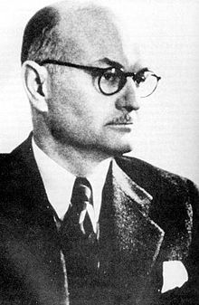
Edward Tolman (1886-1959)

Slide 5
Tolman theorized
learning can occur without outward signs of learning.
learning can occur without any form of reinforcement
mental processes resulted in learning
i.e. thinking about things and doing things results in learning

Slide 6
Rats in a Maze
To demonstrate:
Tolman placed a rat in a maze and allowed it to explore the maze without any reinforcement, such as food
Tolman then placed food at the end
Rat quickly figures out shortest path to food
Tolman then blocked the shortest path
The rat then took the shortest path
Tolman believed the rat had made a cognitive map which demonstated latent learning

Slide 7
Cognitive Map
a mental picture of spatial relationships or relationships between events

Slide 8
Latent Learning
Alteration of a behaviour tendency that is not demonstrated by an observable change in behaviour

Slide 9
Learned Helplessness
Experiment:
Initial phase: 2 groups. first group is able to succeed at a task, second is not.
Task: Shutting off a loud noise with a lever
Secondary phase: same groups, both are able to turn it off
Group that was able to succeed at the first task succeeds at the second task
Group that could not succeed at the first task do not attempt second task

Slide 10
Learned Helplessness
Condition in which repeated attempts to control a situation fail, resulting in a belief that the situation is uncontrollable

Slide 11
Elements of Learned Helplessness
Stable
I have never done well on math tests and I never will
Global
I won’t do well on the English test because I failed the math test
Internalized
I failed because I was weak, not because the teacher or the test was bad

